Slide 1
Passing by Nella Larsen
Biography
Interiority: Literary Devices
Passing
Ambiguity and Queerness in the 1920s

Slide 2
Nella Larsen
Nella Larsen was born in Chicago in 1893 to a Danish mother and a Danish West Indian father, both of whose names have been obscured by history. Nella's father died when she was two, and her mother remarried a man of Danish origin while Nella was still quite young. All biographical references indicate that Nella's step-father was a source of racial tension in Nella's childhood home, which resulted in her alienation from him as well as her mother.

Slide 3
Nella Larson
At 16 Nella went to Denmark for three years to visit her mother's relatives. When she returned to the United States she went to Fisk University, but her stay only lasted one year. Evidently she was dissatisfied with both Fisk and the United States, because when she left Fisk, she left the country as well, going to Copenhagen, where she audited classes at the University of Copenhagen for two years.

Slide 4
Nella Larson
She returned to the United States late in 1914, but this time she went to New York City, where she earned a nursing degree in 1915 from Lincoln Hospital Training School for Nurses. She abandoned nursing in 1918 and began studying to become a librarian.

Slide 5
Nella Larsen
In 1921 she became the children's librarian at the 135th Street branch (Harlem) of the New York Public Library, where she remained until 1929. During this interval she married Elmer S. Imes, a physicist. The couple lived in Harlem, and in all likelihood they were part of upper class African American society.

Slide 6
What “happens” in the Chapters 1 and 2?
Irene is at home in Harlem reading a letter from a a childhood friend named Clare, whom she last met 2 years ago in Chicago
Clare wants to see her again.
Irene reflects her initial encounter Clare in her hometown in Chicago, where they had tea in a hotel and talked about their childhood. Clare makes Irene promise to visit her again before Irene leaves.
Irene (at the end of Chapter 2) decides that she is “through with Clare Kendry.”

Slide 7
What really happens in Chapters 1 and 2: focusing on literary devices and central conflict and themes
Memories
Letters
Steam of consciousness
Free indirect discourse (Narration blurs with a subject’s thought—specifically Irene’s thoughts and feelings)

Slide 8
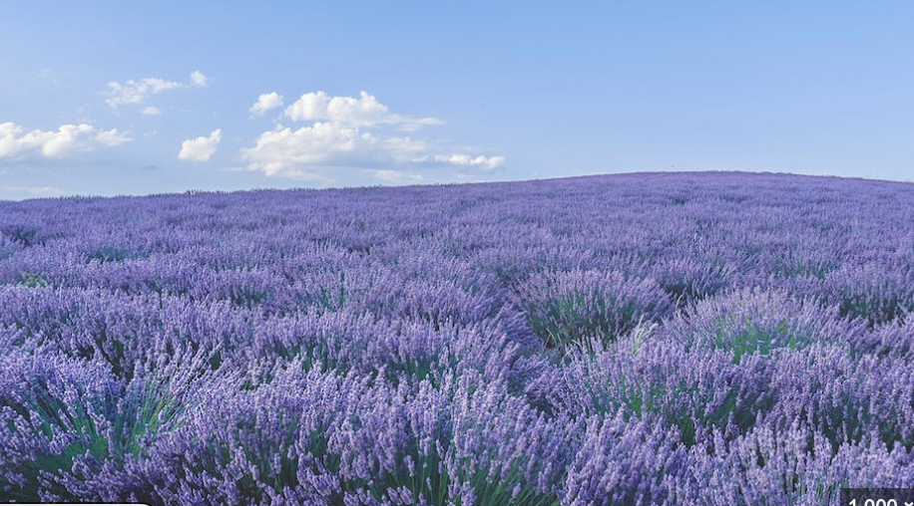
These literary devices help express the central conflict and themes..

Slide 9
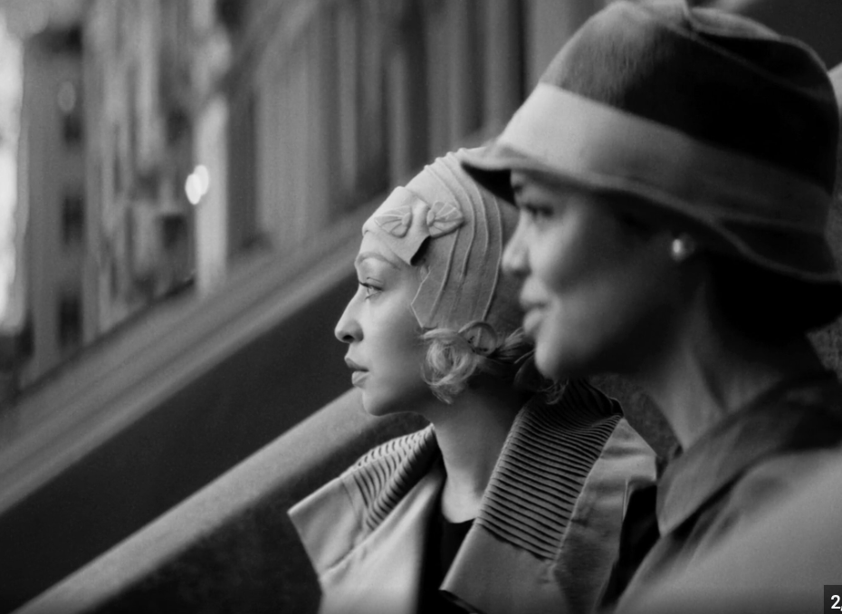
The central conflicts and themes…
Passing:
Presenting one’s self as white (typically when one is of African American background. In the United States, a trace of black racial background can make one a person black (legacy of one drop rule) .
Desire and Intimacy:
Is Irene’s and Clare’s relationship an intense friendship or Queer?
Image from Passing dir. Rebecca Hall (2019)

Slide 10
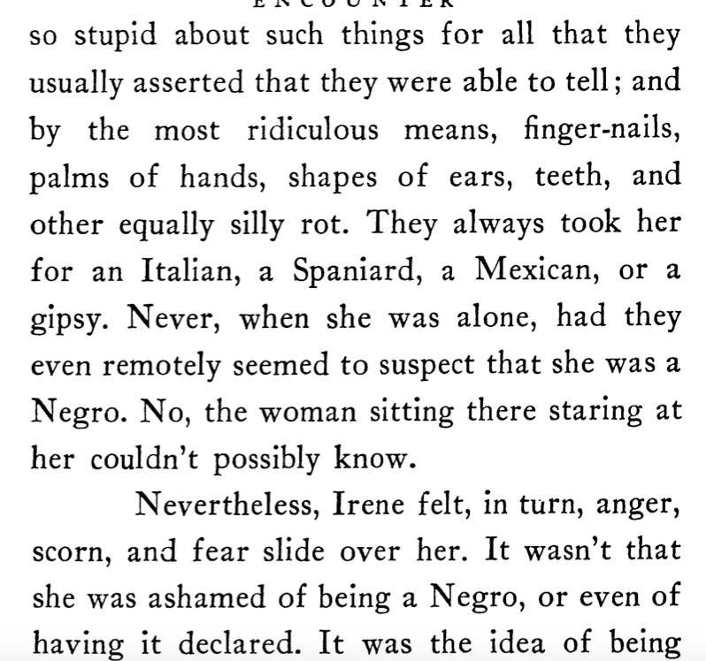
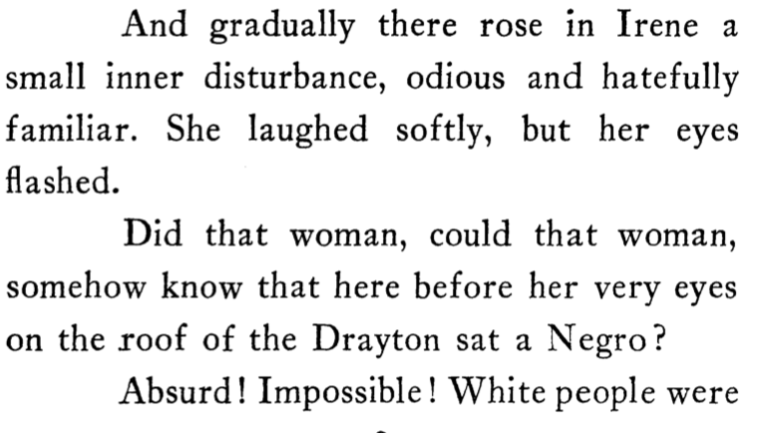
Irene’s Interiority sections from pages 17-18
Can you spot the moment of “free indirect discourse?” How does it shape the idea of passing in the novel?

Slide 11
Ambiguity and Queerness in the 1920s
In 1984 “queer” first widely used to refer to homosexuality.
However…
The Concise New Partridge Dictionary of Slang (1937) notes that it wasn’t until 1914 that ‘queer – a derogatory adjective meaning homosexual’ – was being used more commonly in society (p. 524).

Slide 12
Ma Rainey, Blues, and 1920s Modernity
Ma Rainey “Prove it On Me” (1928)
When I last night, Hade a bad big fight Everything seemed to go on wrong I looked up, to my surprise The gal I was with was gone.
Where she went, I don't know I mean to follow everywhere she goes; Folks say I'm crooked. I didn't know where she took it I want the whole world to know.
They say I do it, ain't nobody caught me Sure got to prove it on me; Went out last night with a crowd of my friends, They must've been women, 'cause I don't like no men.

Slide 13
Another shift expanding the spectrum of gender expectations 1920s…
On one hand, in the 1920s in Black America and especially in,
“Thus, the race ceased to need or revere images of pure black ladyhood as standard-bearers for African American humanity, "civilization,” and fitness for civic inclusion. Her symbolic importance as a pure mother waned and ceased to act as a source of intra-racial political capital for the New Negro woman's participation in the formation of racial advancement discourses”(Chapman, 12).
Chapman, Erin D. Prove It on Me : New Negroes, Sex, and Popular Culture in the 1920s /. New York : Oxford University Press, c2012.

Slide 14
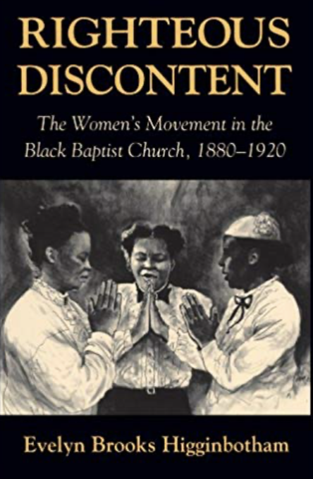
Still there are “respectability politics” and expectation of the New Negro uplifting the race…
“African Americans in particular were generally deeply suspicious of anti-patriarchal social change and politics. In the minds of many, as race and gender were transforming, sexual mores shifting, and morality seemingly falling by the wayside, the meaning of black womanhood needed to remain stable, a pillar against which the race could test its novel successes and a supportive foundation for racial transformations: Race motherhood discourse made New Negro women into such pillars and foundations” (Chapman, 13).

Slide 15
Queerness in Passing
Image from Passing dir. Rebecca Hall (2019)

Slide 16
Passing, Part I: Encounter, Chapter 2
We have description and free indirect again. Can you spot it? What does it do?
(Larsen, 45)

Slide 17
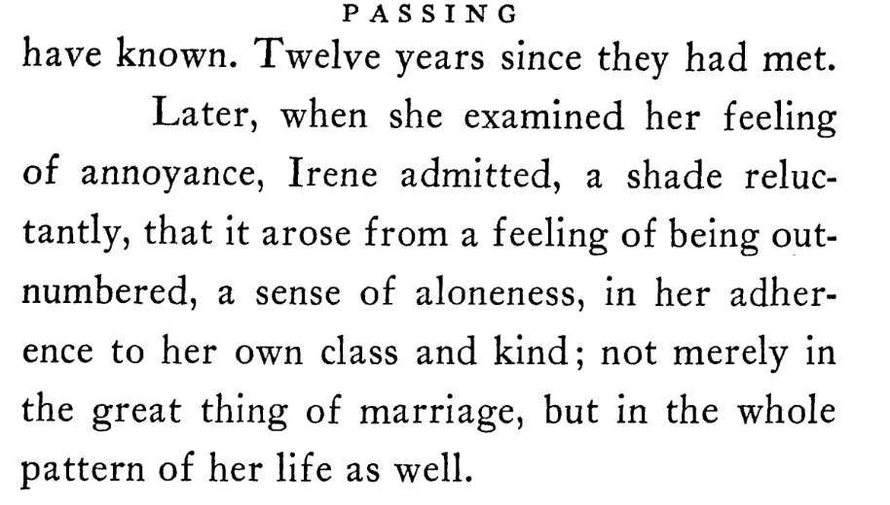
Gertrude…
Friendship through the lens of passing and queer desire…why does Irene resent Gertrude at first?
(Larsen, 55-56)

Slide 18
…and John’s nickname for Clare
Image from Passing dir. Rebecca Hall (2019)

Slide 19
…and John’s nickname for Clare
(Larsen, 67-68)

Slide 20
Reading Chapter 4 of Part I: Letters…avoidance…and Vexed Desires
How do you respond to a ”friend” that you don’t want to be friend with?
What does that text become to you?
How might this help with the letter?

Slide 21
Letters to Re-encounter to thinking about Passing

Slide 22
Letters to Re-encounter to thinking about Passing

Slide 23
Irene and Brian

Slide 24
Irene and Brian
What do you think of Brian’s suggesting that passing is about survival?
Could this be related to what he does for a living?

Slide 26
He doesn’t want to be a doctor anymore…

Slide 27
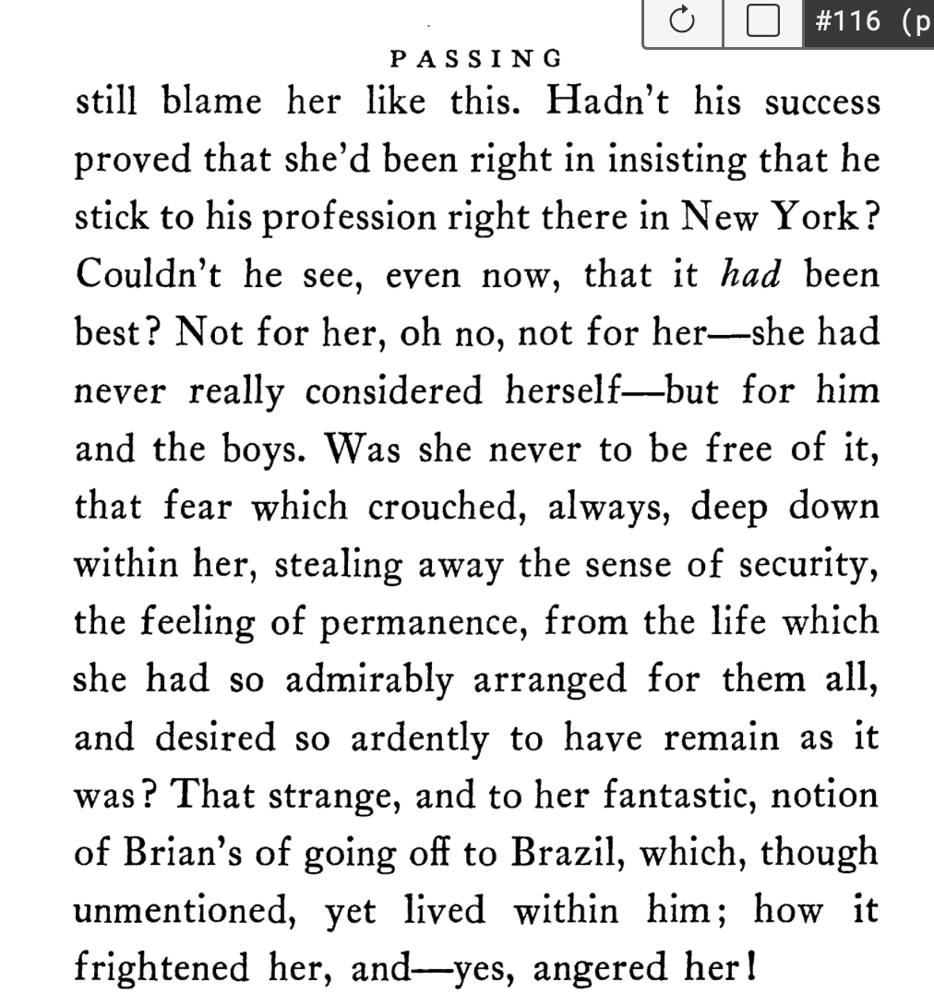
And Irene hates his change. Why?

Slide 28
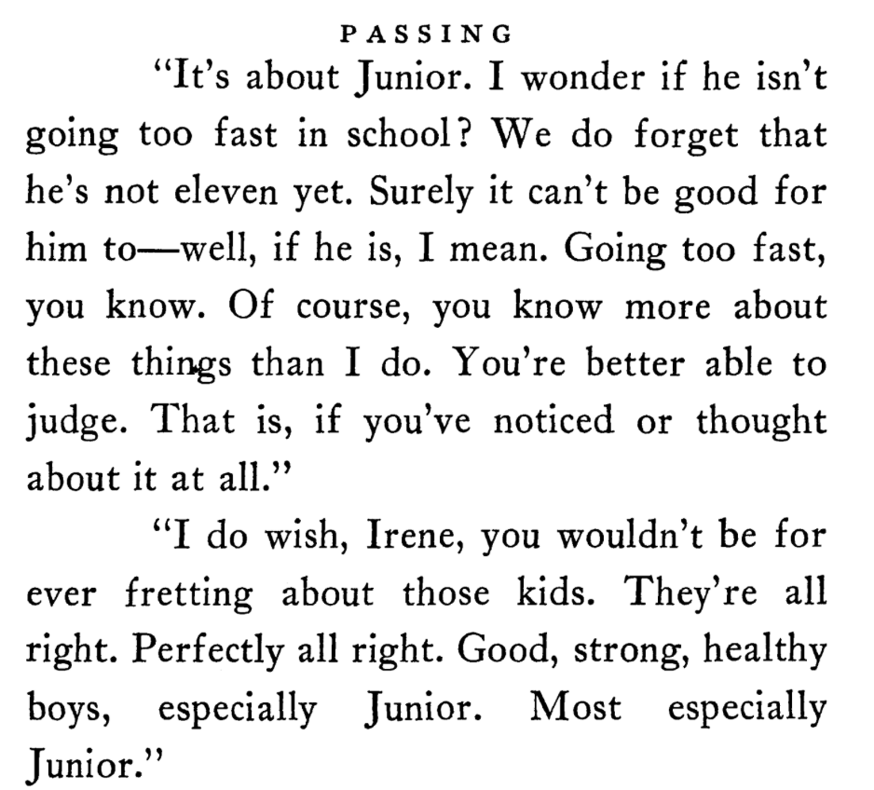
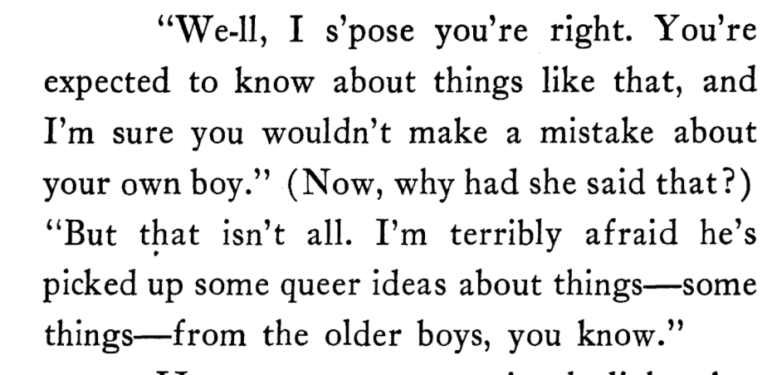
Discussions of sex and “queer talk”
(Pages 103; then 104)

Slide 29
Sex is a “joke”

Slide 30
McDowell, Deborah E. “The Changing Same” : Black Women’s Literature, Criticism, and Theory. Bloomington, Ind: Indiana University Press, 1995.
“How could she give a black female character the right to healthy sexual expression and pleasure without offending the black middle class… We might say that Larsen wanted to tell the story of a black woman with sexual desires as respectable in middle class terms” (McDowell 80).

Slide 31
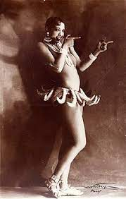
“How could [Larsen] write about black female sexuality in a literary era that often sensationalized it and pandered to the stereotype of the primitive exotic? (McDowell, 80, my emphasis)
Exoticism describes a cultural phenomenon that projects Western fantasies about profound cultural differences. It adopts a cultural perspective that is firmly entrenched in the conventions and belief systems of Western civilization and therefore constructs the East as the archetypical location of otherness.
Josephine Baker in Banana Skirt from the Folies Bergère production "Un Vent de Folie" (1927)

Slide 32
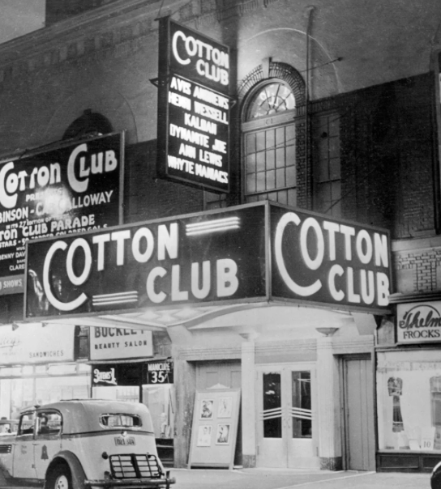
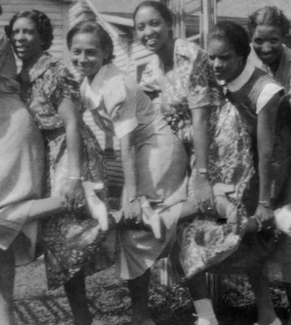
Harlem Renaissance (1919-1930s)
More openness about gender and sex
Loosening of Gender Role
More salient queer culture
More interracial mingling
Jazz
White patrons and Black artists

Slide 34
Film Adaptation Passing (2021) written and directed by Rebecca Hall
Reading the story of these fictional women, Hall realized that her maternal grandfather had also passed as white.
Hall on her mother’s background: “To me, she always looked Black. Certainly growing up in the English countryside and going to a very white private schools, I was aware of her difference. But it was a thorny subject matter, not because she wouldn't give me answers. She couldn't. She didn't really have access to the information, either. So I would ask her, I would say, "What are we? What's our heritage? Tell me about your father?" And she would say, "I don't really know. It's possible that he was a bit Black or a bit Native American. I don't really know." ...
https://www.npr.org/2021/11/30/1059824073/passing-rebecca-hall-film

Slide 35
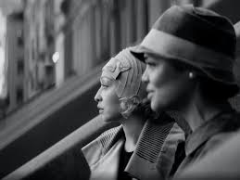
Adaptation
Both film and fiction strive to connect with audiences, but the means by which they do so are different.
When you watch a movie you are watching characters on camera you see what they see as opposed to looking through their eyes.
Literature allows for a more intimate experience by immersing readers in a character’s inner world of fantasies, fears, and urges that go unexpressed.
This ability to slip into a character’s thoughts while she muses is one of the main reasons we read.
Image from Passing (2021) dir. Rebecca Hall

Slide 36
Interiority
Novelists and short story writers bring a different set of tools to the arena: language, interactivity, and, most importantly, interiority.
What is interiority? Internal thoughts, reflections, feelings; sometimes psychological or spiritual.

Slide 37
What Shapes Interiority?
Social Experiences
Social Expectations

Slide 38
I asked my class last year, what does Irene want from Clare based on the opening scene of the film?
Maybe she just wants to catch up
I think Clare wants Irene’s identity and her husband!
Friendship
To see what her life is like now
Connect with something real
Friendship
I think Clare wants to be everything. Clare wants to feel validated in her Blackness (being around Irene) while reaping the benefits of passing as white.
friendship
Wants to see what her life could've been. if she embraced her blackness more
Friendship/Companionship, Security, Perspective
Clare looks like she wants to be part of the black community again.
reconnect with her black side
to be accepted and acclimated back to her community
She wants her lips
to reminisce her past

Slide 39
How does the novel end? How does the film end?

