Slide 1
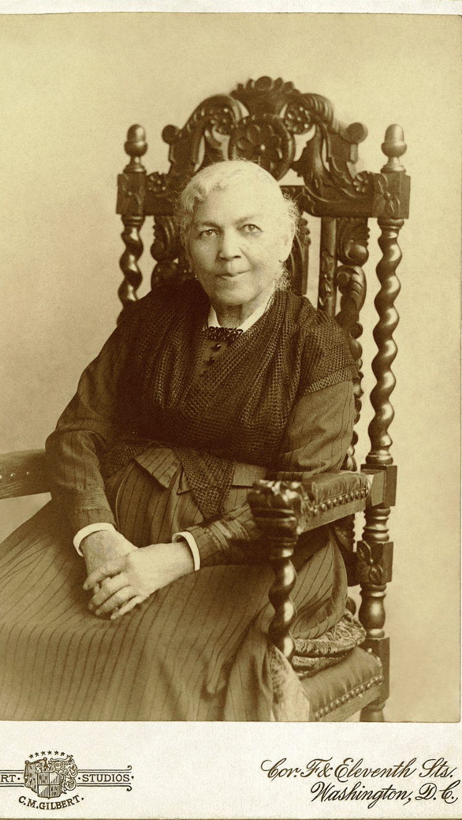
Incidents in the Life of a Slave Girl (1861)
By Harriet Jacobs
Harriet Jacobs’s only known formal portrait, taken in 1894 about three years before her death. Used with permission.

Slide 2
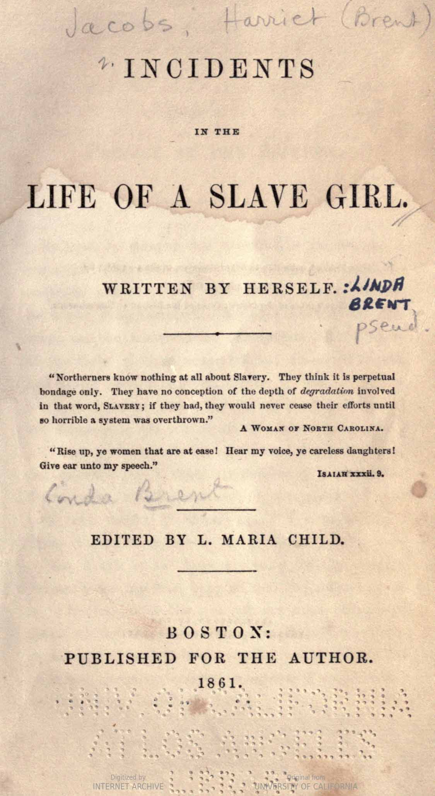
Slave Narratives authorship and audience
The image to the left is the title page of Harriet Jacobs’s narrative. The page can tell us a lot about how the work is advertised and how American society during the antebellum period thought about Black authorship….

Slide 4
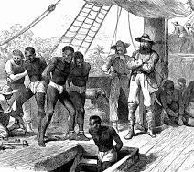
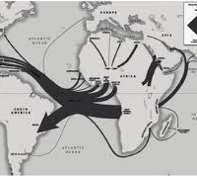
Some Context on Slavery
Began in 1619 when 20 African slaves brought to a Virginia colony in Jamestown.
In the 17th century and 18th century more slaves were brought from Africa to the United states in to work to produce agricultural crops like, rice, sugar, tobacco, and cotton. The journey those Africans took from African to the Americans and Caribbean took is called Middle Passage.
The Trans Atlantic slave trade ended in 1801. Internal slave trade continued in the U.S. What does that mean in terms of the population of slaves in America?

Slide 5
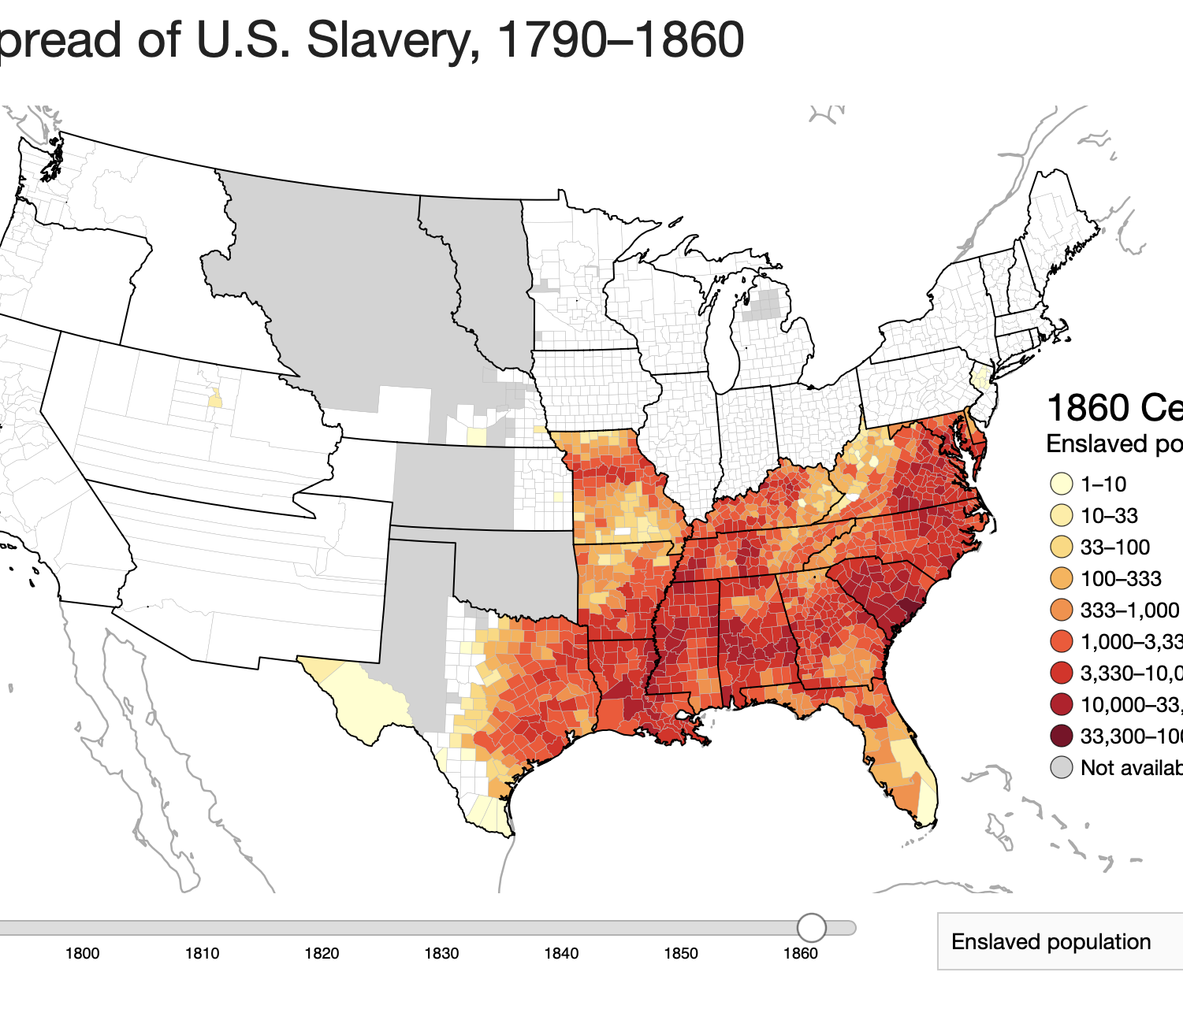
As the United states Expanded so Did slavery and opposition
https://lincolnmullen.com/projects/slavery/

Slide 6
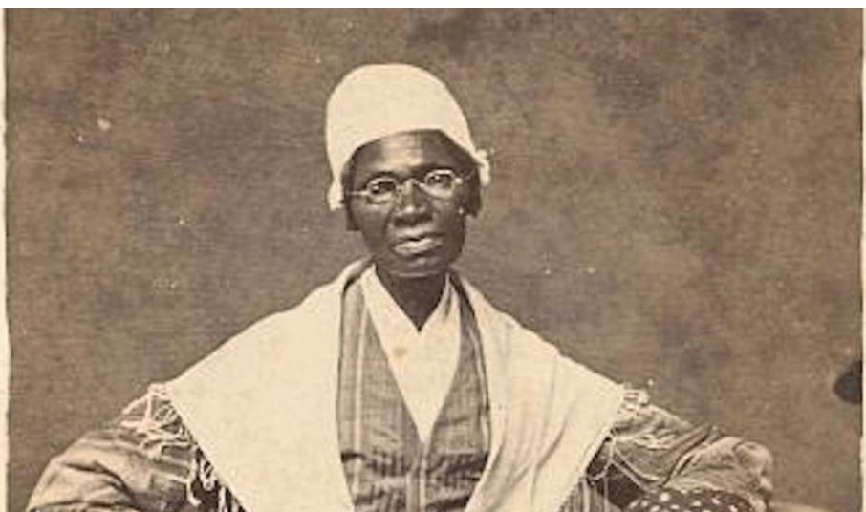
The North and Abolitionists
Abolitionists are people who sought to bring an end to slavery in America by fully emancipating black slaves.
Abolitionists tended to be northern white religious Americans and very often freedmen and freedwomen who escaped from slavery.
Top to Bottom: Sojourner Truth (1797-1883); William Lloyd Garrison (1805-1879); Frederick Douglass (1818-1895)

Slide 7
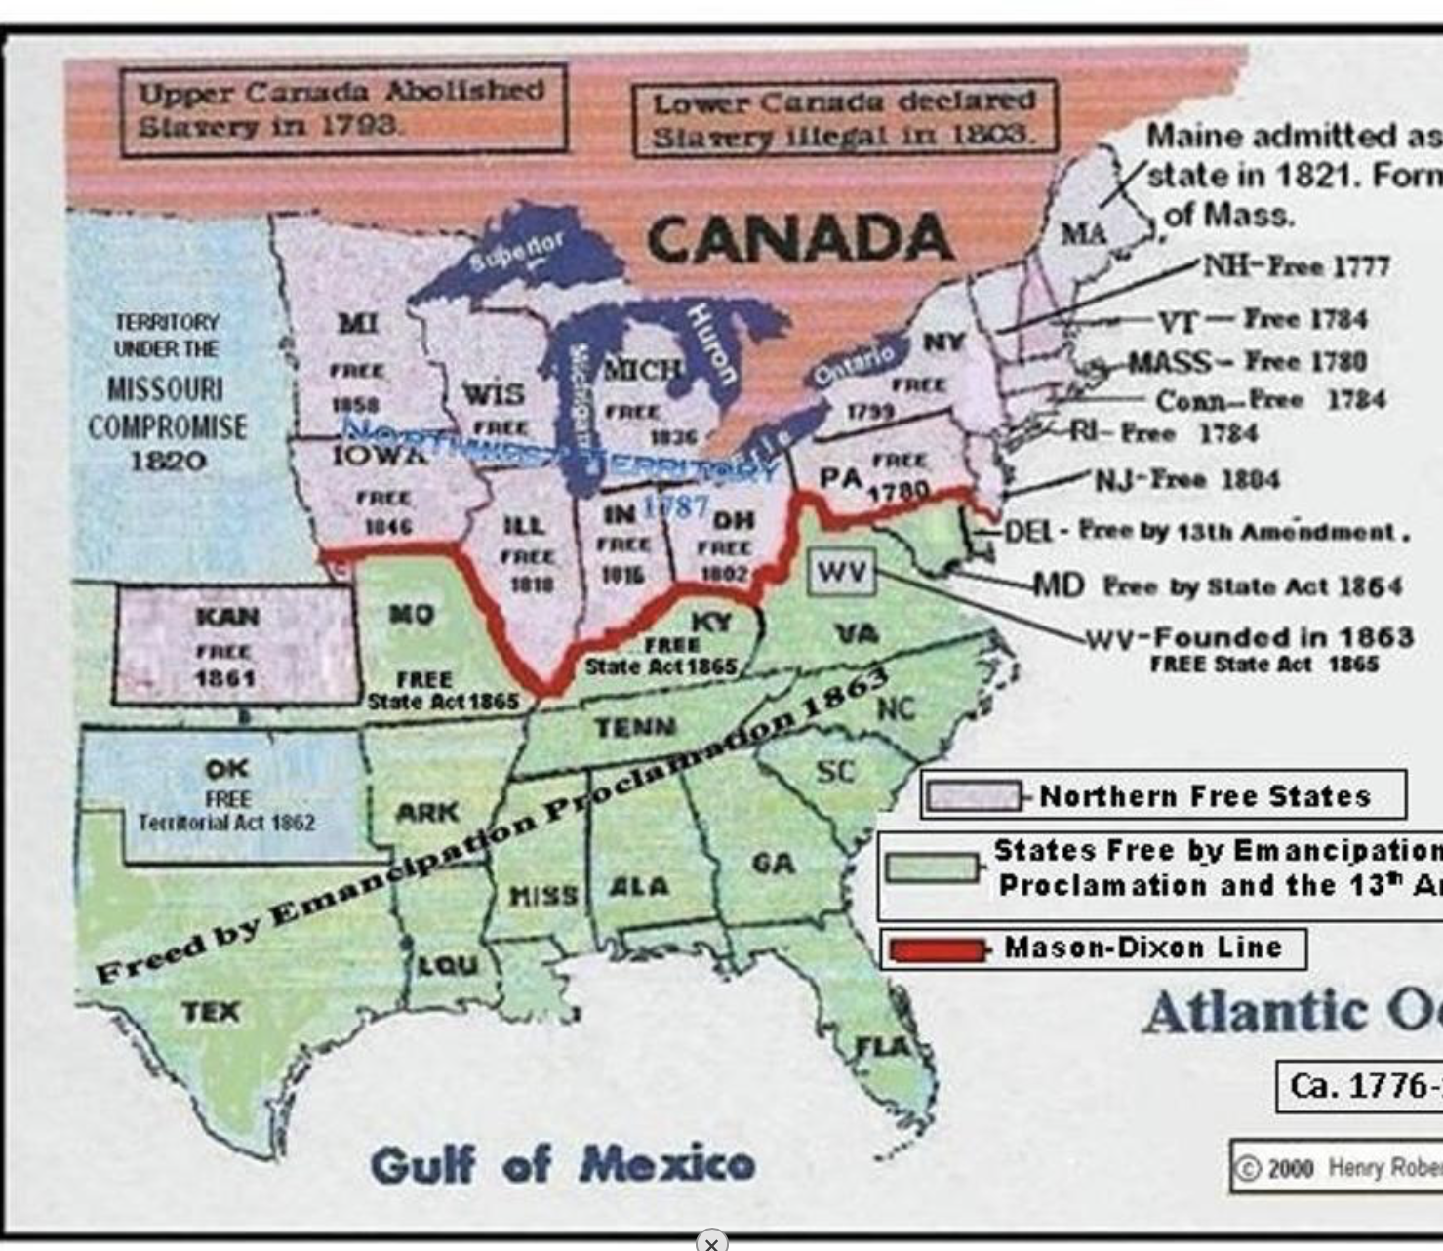
Abolitionists And the North
In 1820 the Missouri Compromise was created to establish which parts of the U.S. free states and which had slavery as the U.S. expanded West. With this compromise it was also established that states above the Mason Dixon Line were “free states” where slavery was not practiced and below were slave territories.

Slide 8
Abolitionism to Civil Back to Harriet Jacobs
The movement began as early as 1816 gained momentum in the 1830s when Great Britain abolished slavery. In the United States, slavery became a increasing pressing issue leading up to the Civil War.
The Missouri Compromise 1820 raised tensions between the North and the South, creating limits on slavery even as it expanded into new territories.
The Fugitive Slave Act of 1850, which required that U.S. citizens to return escape slave brought tensions to an all time high,.
In the chat: Why do you think the Fugitive Slave Act exacerbated tension around slavery amongst American Citizens?

Slide 9
Tension and Timing…Looking at the title page again
The Civil War takes place from 1861 to 1865…

Slide 10
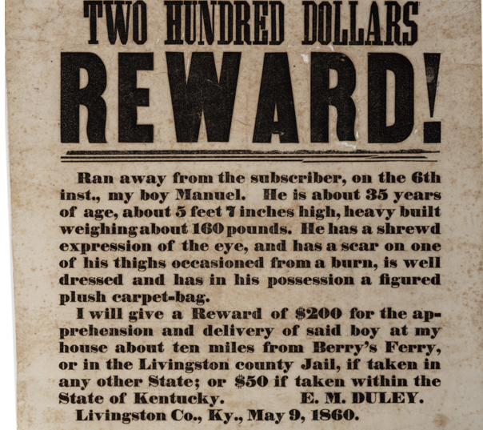
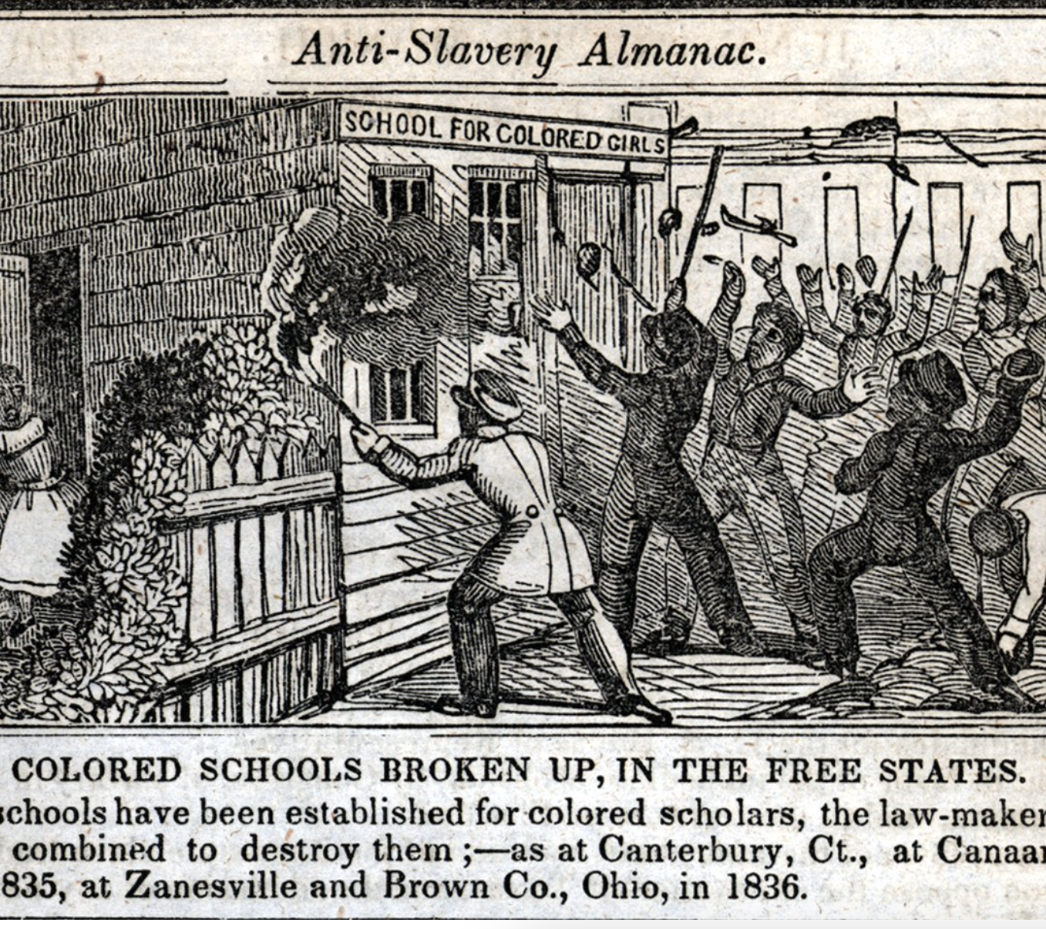
Traits of a Slave Narrative
Both biography and story with the goal of getting American society to understand and end slavery. It is a life story that is crafted to achieve societal change. But what kind of society are authors of slave narratives writing to?
Slaves not allowed to read or write (restricted by law). Those who taught them also punishable by law.
Slaver owners often used notes or written passes to have slaves travel.
Why else reading and writing might be outlawed for slaves?

Slide 11
Testimony of a white citizen (L. Maria Child
Harriet Jacobs is the actual author name. “Linda Brent” is her Pseudonym

Slide 12
Incidents in the Life of a Slave Girl (1861) by Harriet Jacobs
Ethos (an author’s credibility)
Social Death (intro to definition)

Slide 13
Ethos :another way to think about Authorship and audience
Greek for “character”
Created and performed through the way the author writes (or speaks)
Authors have ethos if they have credibility to the audience or reader

Slide 14
How Does Harriet Jacobs Establish her Ethos?

Slide 15
“Reader be assured this narrative is no fiction. I am aware that some of my adventures may seem incredible; but they are, nevertheless, strictly true. I have not exaggerated the wrongs inflicted by Slavery; on the contrary, my descriptions fall far short of the facts. I have concealed the names of places, and given persons fictitious names. I had no motive for secrecy on my own account, but I deemed it kind and considerate towards others to pursue this course (”Preface,” Harriet Jacobs)

Slide 16
“ I wish I were more competent to the task I have undertaken. But I trust my readers will excuse deficiencies in consideration of circumstances. I was born and reared in Slavery; and I remained in a Slave State twenty-seven years. Since I have been at the North, it has been necessary for me to work diligently for my own support, and the education of my children. This has not left me much leisure to make up for the loss of early opportunities to improve myself; and it has compelled me to write these pages at irregular intervals, whenever I could snatch an hour from household duties.,” (“Preface,” Harriet Jacobs)

Slide 17
Ethos in the slave narrative persuading readers

Slide 18
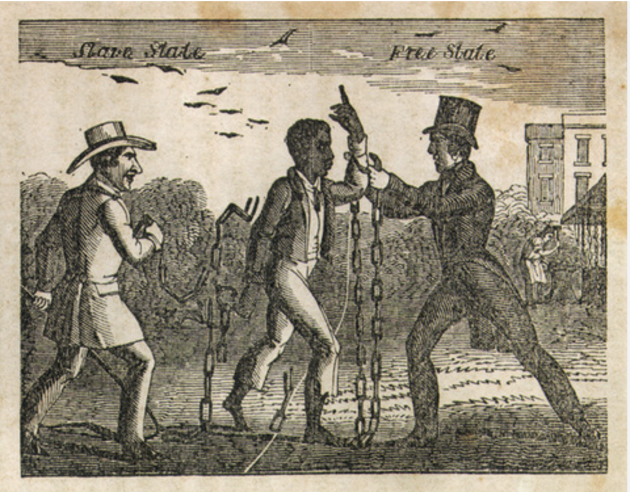
A little Review of North Versus South
To think about how Harriet Jacobs appeals to Northern…

Slide 19
Abolitionists And the North
In 1820 the Missouri Compromise was created to establish which parts of the U.S. free states and which had slavery as the U.S. expanded West. With this compromise it was also established that states above the Mason Dixon Line were “free states” where slavery was not practiced and below were slave territories.

Slide 20
How might the following Passage impact Northerners?

Slide 21
VII. What Slaves Are Taught to think of the North
“A slaveholder once told me that he had seen a runaway friend of mine in New York, and that she besought him to take her back to her master, for she was literally dying of starvation; that many days she had only one cold potato to eat, and at other times could get nothing at all. He said he refused to take her, because he knew her master would not thank him for bringing such a miserable wretch to his house. He ended by saying to me, “This is the punishment she brought on herself for running away from a kind master.”

Slide 22
VII. What Slaves Are Taught to think of the North
“This whole story was false. I afterwards staid with that friend in New York, and found her in comfortable circumstances. She had never thought of such a thing as wishing to go back to slavery. Many of the slaves believe such stories, and think it is not worth while to exchange slavery for such a hard kind of freedom. It is difficult to persuade such that freedom could make them useful men, and enable them to protect their wives and children.”

Slide 23
How might these Passage impact Northerners?

Slide 24
VII. What Slaves Are Taught to think of the North
“A slaveholder once told me that he had seen a runaway friend of mine in New York, and that she besought him to take her back to her master, for she was literally dying of starvation; that many days she had only one cold potato to eat, and at other times could get nothing at all. He said he refused to take her, because he knew her master would not thank him for bringing such a miserable wretch to his house. He ended by saying to me, “This is the punishment she brought on herself for running away from a kind master.”

Slide 25
Remember the Fugitive Slave Law (1850)?
Passed on September 18, 1850 by Congress, The Fugitive Slave Act of 1850 was part of the Compromise of 1850. The act required that slaves be returned to their owners, even if they were in a free state.

Slide 26
What do You notice about Gender Or Religion?
“But while the Free States sustain a law which hurls fugitives back into slavery, how can the slaves resolve to become men? There are some who strive to protect wives and daughters from the insults of their masters; but those who have such sentiments have had advantages above the general mass of slaves. They have been partially civilized and Christianized by favorable circumstances. Some are bold enough to utter such sentiments to their masters. O, that there were more of them!” (Jacobs, VII. What Slaves are Taught to Think of the North)

Slide 27
Use of Rhetorical Questions and “you”
“Some poor creatures have been so brutalized by the lash that they will sneak out of the way to give their masters free access to their wives and daughters. Do you think this proves the black man to belong to an inferior order of beings? What would you be, if you had been born and brought up a slave, with generations of slaves for ancestors? I admit that the black man is inferior. But what is it that makes him so? It is the ignorance in which white men compel him to live; it is the torturing whip that lashes manhood out of him; it is the fierce bloodhounds of the South, and the scarcely less cruel human bloodhounds of the north, who enforce the Fugitive Slave Law. They do the work. (Jacobs, VII What Slaves are Taught to Think of the North”

Slide 28
Incidents in the Life of a Slave Girl by Harriet Jacobs
Social Death—What can it look like?
Cult of True Womanhood
What is Love?
Loophole of Retreat

Slide 29
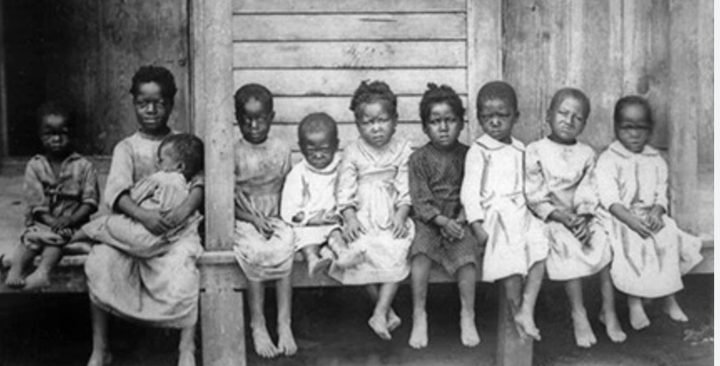
“I Was born…”
“I was born a slave; but I never knew it till six years of happy childhood had passed away (I. Childhood, Jacobs).
A key trait or aspect of slave narratives includes slaves not knowing their exact birthday. Their recognition of self includes learning what it means to be a slave.

Slide 30
The Social Death of the Slave
Orlando Patterson theorizes “social death” as “the most distinctive attribute of the slave’s powerlessness [that was conceived of] as a substitute for death… because the slave had no socially recognized existence outside of his master, [was considered] a social nonperson.”
Patterson, Orlando. Slavery and Social Death : A Comparative Study. Harvard University Press, 1982.

Slide 31
Group Work
A key trope of slave narratives: the slavery separating families
In breakout rooms, find 3 short passages (no more that 5 sentences), that reflect the separation of family, the dismissal of family relations, or the master as primary or foremost social connection.
Create a google doc with the passages, citations, and a couple of sentences about what you notice in the passage (how is an example of or illustrates social death or a main trait of the separation of families)?
20 mins then regroup for class discussion

Slide 32
Cult of True Womanhood: Tyrone
Women were assigned the primary role of domesticity. They were expected to excel in household tasks such as cooking, cleaning, child-rearing, and managing the household. Their worth and success were often measured by their ability to create a warm and nurturing home environment for their families.
In contrast, men were expected to embody characteristics associated with strength, assertiveness, and the role of the provider. They were expected to be the breadwinners of the family, responsible for earning a living and financially supporting their households. Men were seen as the leaders and decision-makers, both within the family and in society.

Slide 33
Cult of True Womanhood: Nazia
The difference between women and men according to the true cult of womanhood is that the woman are separated from the outside world and the man is expected to take care of the economic world outside. Women are expected to stay at home, and take care of the children versus the men’s role is to work, and provide for the family. This is what’s ideal and shows high status.

Slide 34
Cult of True Womanhood: Marine
How can the “cult of true womanhood” help us think about Linda’s boundaries and the way she affirms herself? Are there limitations to Linda’s focus on being virtuous?
Harriet Jacobs, also known as Linda, courageously challenges the expectations of piety, purity, submissiveness, and domesticity imposed on women, particularly enslaved women, during her time. By continuously refusing to submit to her master’s will she defies the dehumanizing nature of slavery and asserts her strength and resilience. She uses her voice to speak up despite the anger and consequences it causes her. When her purity is forcibly taken away, she then asserts control over her own body and takes agency in choosing her next partner as a means to reclaim her sense of self.
However, it is crucial to recognize that her actions are shaped by the oppressive environment in which her freedom and autonomy are violated. It is difficult to fully comprehend the extent of her character outside of the context of abuse and the intersecting forces of slavery and sexism.

Slide 35
What does Love become When you do not Own your Body?
Considering Linda’s Lover and Mr. Sands

Slide 36
VII. The Lover
Linda’s first lover is another free slave—we never learn his name-–only that he is a carpenter. Who else was a carpenter if you recall?
“Why does the slave ever love? Why allow the tendrils of the heart to twine around objects which may at any moment be wrenched away by the hand of violence? When separations come by the hand of death, the pious soul can bow in resignation, and say, “Not my will, but thine be done, O Lord!” But when the ruthless hand of man strikes the blow, regardless of the misery he causes, it is hard to be submissive. I did not reason thus when I was a young girl. ”

Slide 37
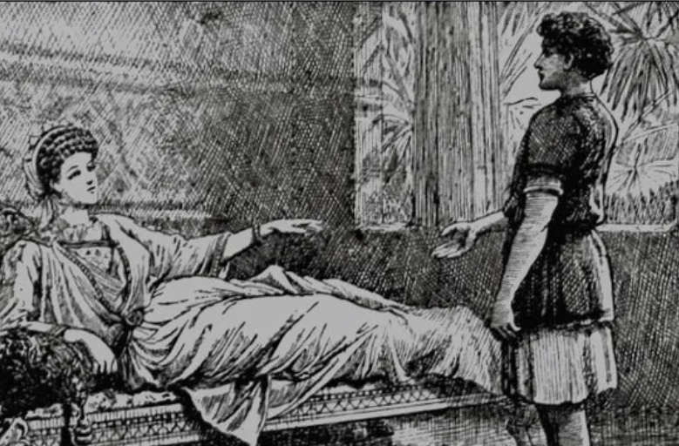
Related to “VII. the Lover”…thinking about Black Boyhood and Manhood
“One day, when his father and his mistress both happened to call him at the same time, he hesitated between the two; being perplexed to know which had the strongest claim upon his obedience. He finally concluded to go to his mistress. When my father reproved him for it, he said, “You both called me, and I didn’t know which I ought to go to first.”
“You are my child,” replied our father, “and when I call you, you should come immediately, if you have to pass through fire and water.”
Poor Willie! He was now to learn his first lesson of obedience to a master. (“II. The New Master and Mistress,” Jacobs).
Flavia interrogates her slave Malchus, from the book The Young Carthaginian: A Story of the Times of Hannibal by G. A. Henty, published in 1887. Illustrated by C. J. Staniland.

Slide 38
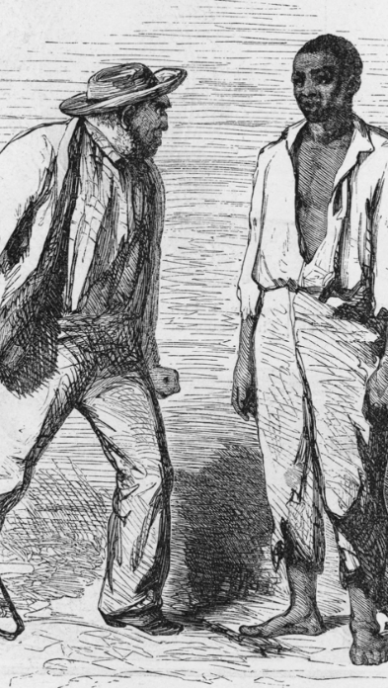
Related to the Lover…thinking about Black Boyhood and Manhood
“It appeared that Benjamin’s master had sent for him, and he did not immediately obey the summons. When he did, his master was angry, and began to whip him. He resisted. Master and slave fought, and finally the master was thrown. Benjamin had cause to tremble; for he had thrown to the ground his master—one of the richest men in town. I anxiously awaited the result (“IV. The Slave Who Dared to Feel Like Man,” Jacobs).
An illustration of a man with a whip standing next to an African American slave from the novel 'Uncle Tom's Cabin,' by American novelist Harriet Beecher Stowe, 1852 .Kean Collection / Getty Images

Slide 39
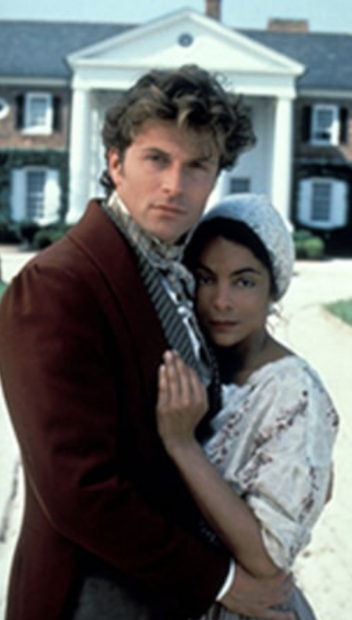
What does “Akin to Freedom” Mean?
“So much attention from a superior person was, of course, flattering; for human nature is the same in all. I also felt grateful for his sympathy, and encouraged by his kind words. It seemed to me a great thing to have such a friend. By degrees, a more tender feeling crept into my heart. He was an educated and eloquent gentleman; too eloquent, alas, for the poor slave girl who trusted in him. Of course I saw whither all this was tending. “X. A Perilous Passage in a slave girl’s life”, Jacobs)”
Image from Queen, 1993 mini Series based on book by Alex Haley

Slide 40
What does “Akin to Freedom” Mean?
“I knew the impassable gulf between us; but to be an object of interest to a man who is not married, and who is not her master, is agreeable to the pride and feelings of a slave, if her miserable situation has left her any pride or sentiment. It seems less degrading to give one’s self, than to submit to compulsion. There is something akin to freedom in having a lover who has no control over you, except that which he gains by kindness and attachment. A master may treat you as rudely as he pleases, and you dare not speak; moreover, the wrong does not seem so great with an unmarried man, as with one who has a wife to be made unhappy. There may be sophistry in all this; but the condition of a slave confuses all principles of morality, and, in fact, renders the practice of them impossible (“X. A Perilous Passage,” Jacobs)

Slide 41
“XXI. Loophole of Retreat”
What is the impact or effect Jacob’s description of the garret (attic)? Why does she so detail oriented?
Irony involves contradiction of our perceived reality. To put it another way: irony is a contrast between “what seems to be” and “what is.” Irony occurs when a moment of dialogue or plot contradicts what the audience expects from a character or story. In other words, irony in literature happens when the opposite of what you’d expect actually occur. What are the ironies in this chapter?
https://writers.com/irony-definition

